Slide 1
Marketflash - Buisness Performance
Mini Project of Masterschool
Presenter & Creator: Alexander Kuhn

Slide 2
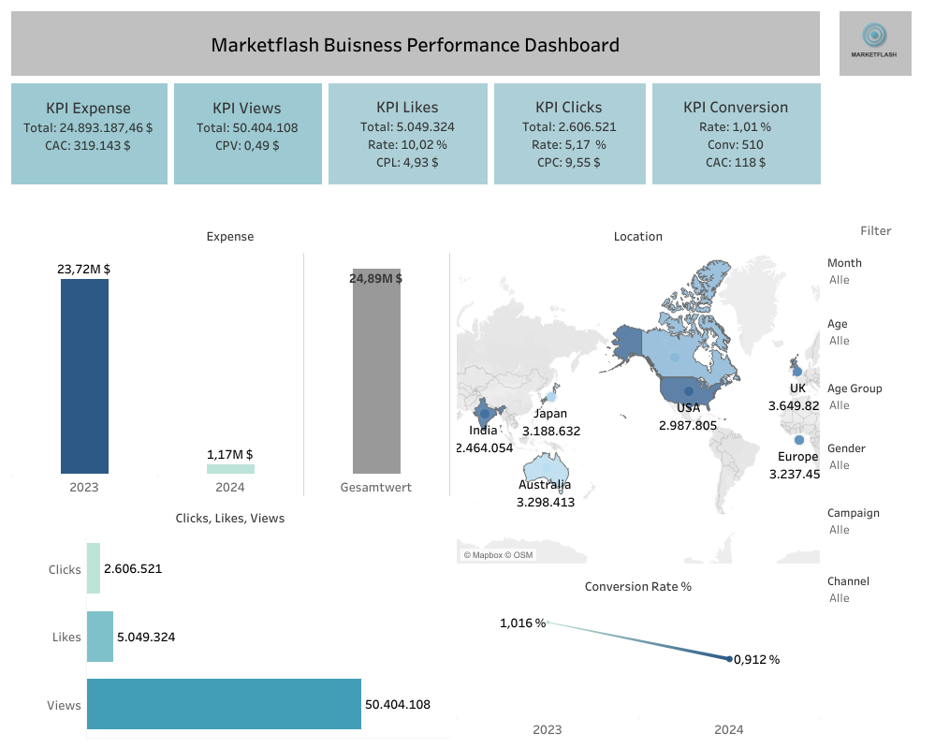
Dashboard

Slide 3
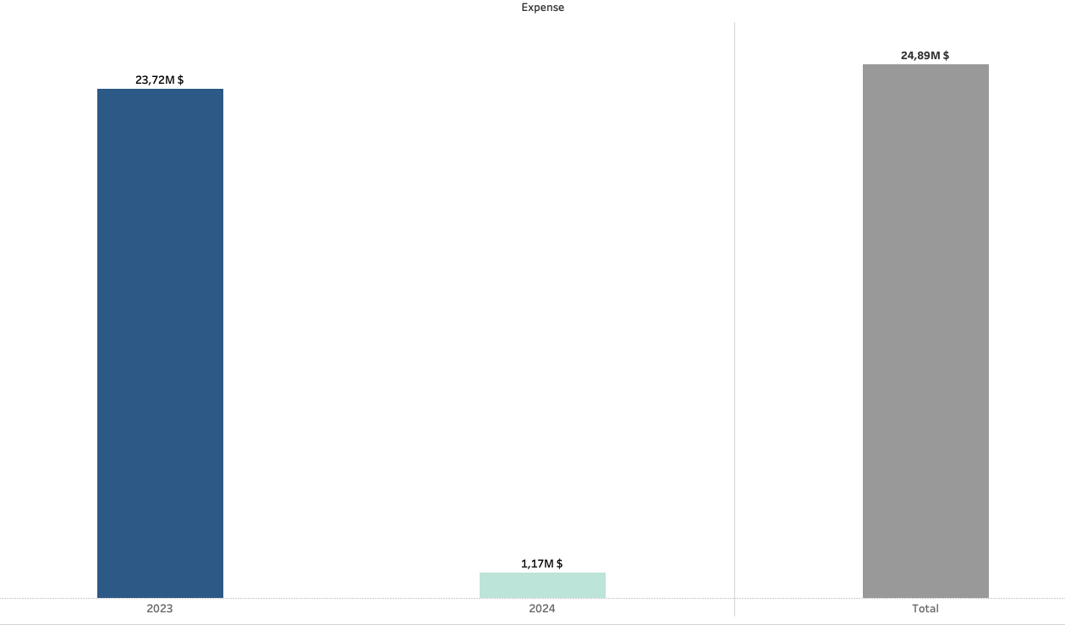
Expense

Slide 4
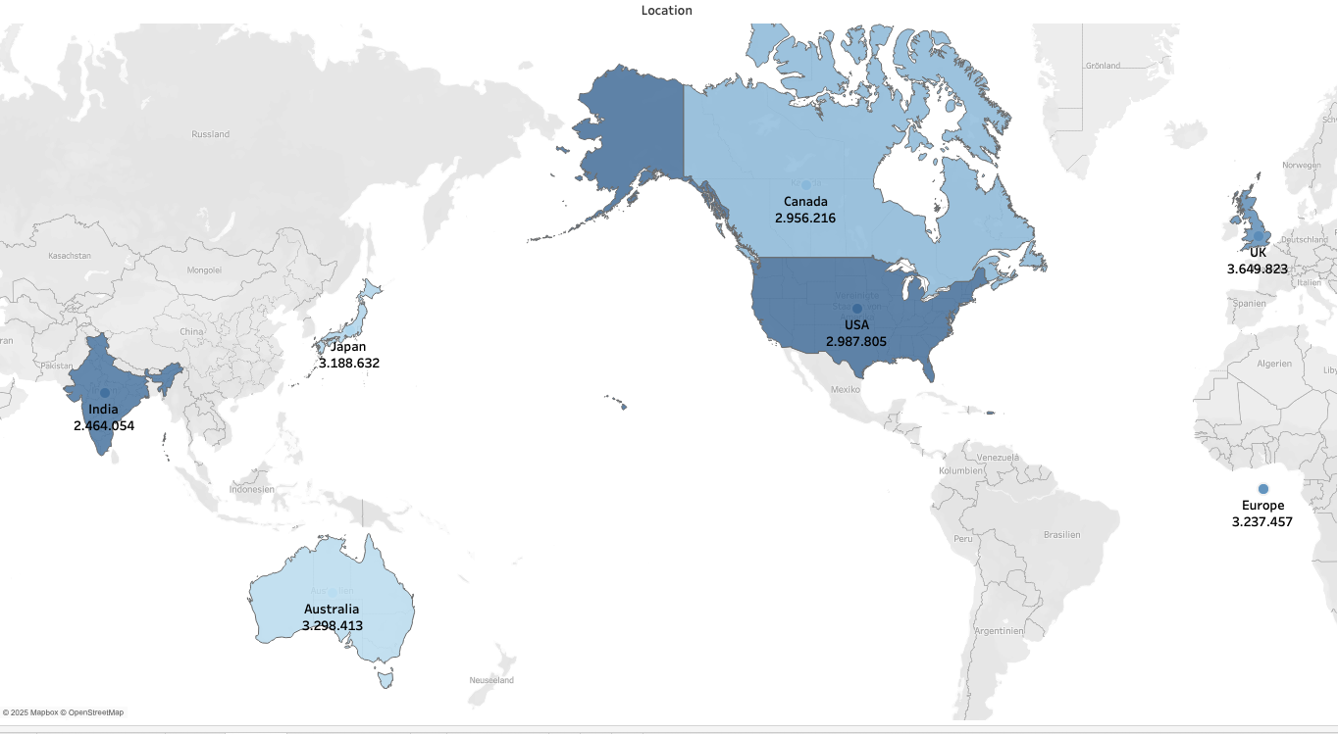
Location

Slide 5
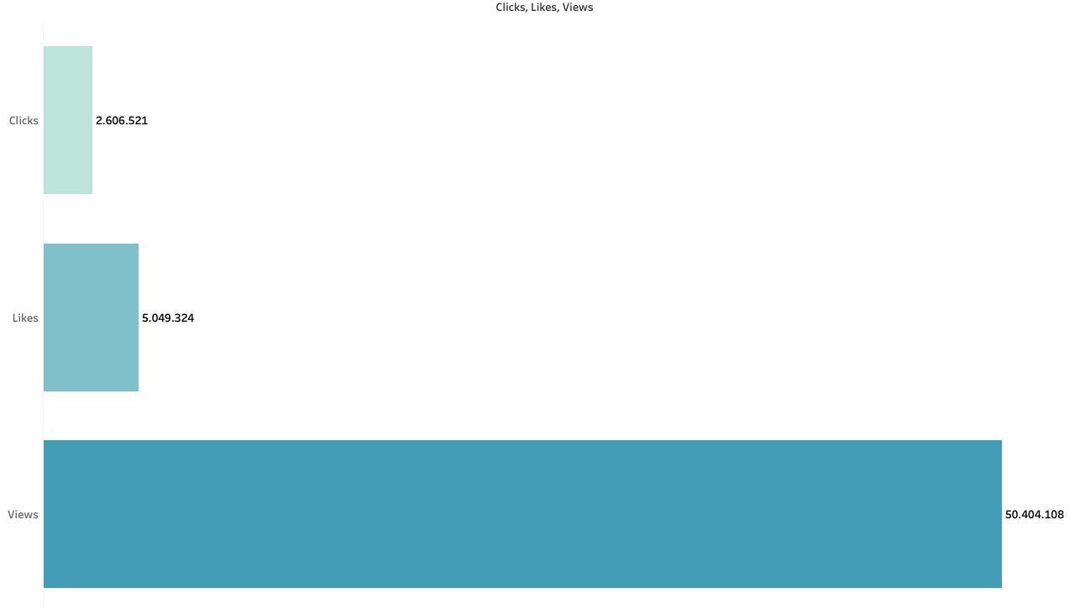
Location

Slide 6
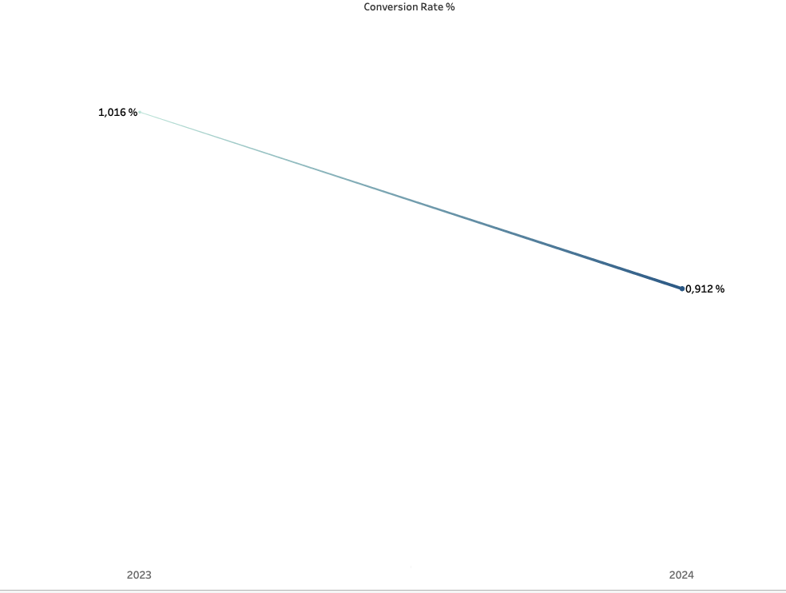
Location

Slide 7
Summary

